Slide 1
Lesson: Remote Deployment to the Phone
This will literally save you hours (no pun today)
Ben Schwarz

Slide 2
Why is this necessary?
Anyone who has written an autonomous for ftc can tell you that it a mighty pain to connect the cable to make a small change every time.
So, instead we can deploy remotely using the Android Debug Bridge(ADB) protocol (Would of loved this back in the day).
Only Downside is not as fast because it is over Wifi (however given the cables it is worth it)

Slide 3
How does this work?
It uses the Android Debug Bridge (adb). It’s a command-line tool that allows you to communicate with a device.
The command facilitates a variety of device actions such as . ADB allows programs to be stopped and started, files to be copied to or from the device, new APKs to be installed, running processes’ CPU and memory to be monitored, and logs to be accessed (amongst many other actions).
This ADB protocol can be used over a network, so long as it is enabled on the device, via USB, after each time the device has been restarted.
Adb is included in the Android SDK Platform-Tools package.

Slide 4
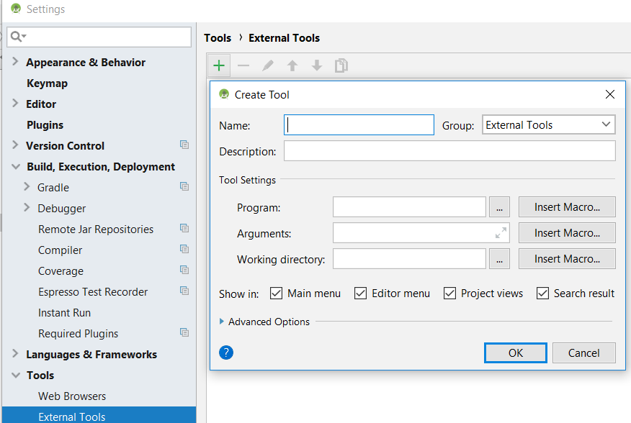
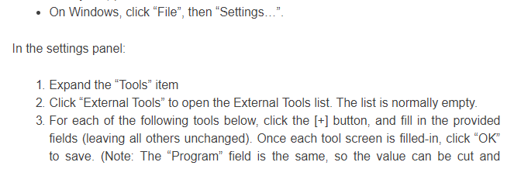
Setup:
Normally to enable this it requires using the command line. However, android studio has an external tools feature which can do this automatically.
Step 1:

Slide 5
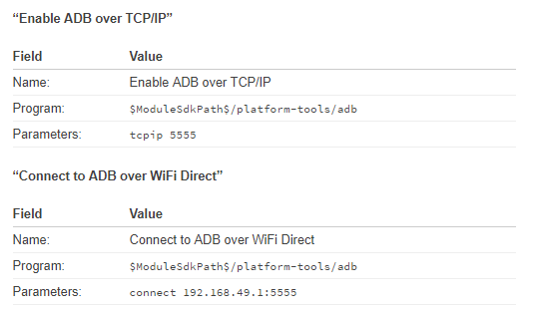
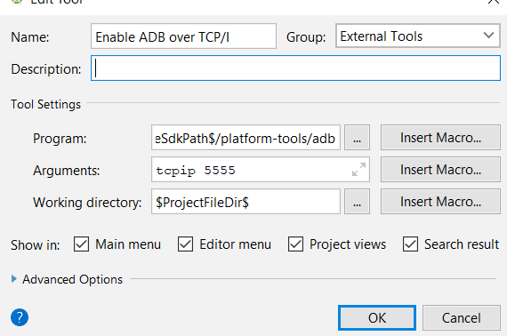
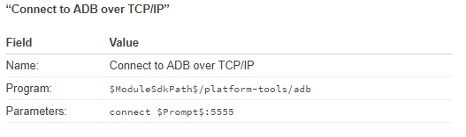
Step 2 – Create the following 3 External Tools:

Slide 6
Pushing code steps:
1.Join the Wifi Direct network from the PC.
The name of the WiFi Direct network is somewhat obvious because it’s based on the device name, which is visible in the FTC apps: something like “DIRECT-xy-1234-RC”
The Password to join can be found using the “Program & Manage” screen in the Robot Controller app’s main menu.

Slide 7
Pushing Code Steps
2. Connect the robot’s Android device to the PC via USB.
3. Ensure that a file (such as an OpMode) is open and the cursor is in that window
4. Click Tools -> External Tools -> “Enable ADB over TCP/IP” to enable ADB.
5. Disconnect the USB cable from the phone and double check the computer is connected to the WiFi Direct network.
6. Ensure the “FTC Robot Controller” app is running on the Android device.
7. Click Tools -> External Tools -> “Connect to ADB over Wifi Direct” to connect to the ADB.

Slide 8
Pushing Code
After these steps just click the run button (green triangle) and select the phone.
Steps 2-4 have to be completed every time the phone is restarted.
The other steps have to be completed every time you disconnect from the phone.

Slide 9
Bonus: Use Android Monitor logcat in real time!
The device is connected via ADB while the robot is running…
This means the Android Monitor is usable while the robot is running.
If the Android logging API (android.util.log) is used to log messages, they will appear in the Android Monitor’s logcat in real time!

Slide 10
Finally:
Credit to Jeremy Cole
Large Parts of this were shamelessly ripped from his tutorial.
Link: https://blog.jcole.us/2017/04/13/wireless-programming-for-ftc-robots/#connect-wirelessly-to-program

